Slide 1
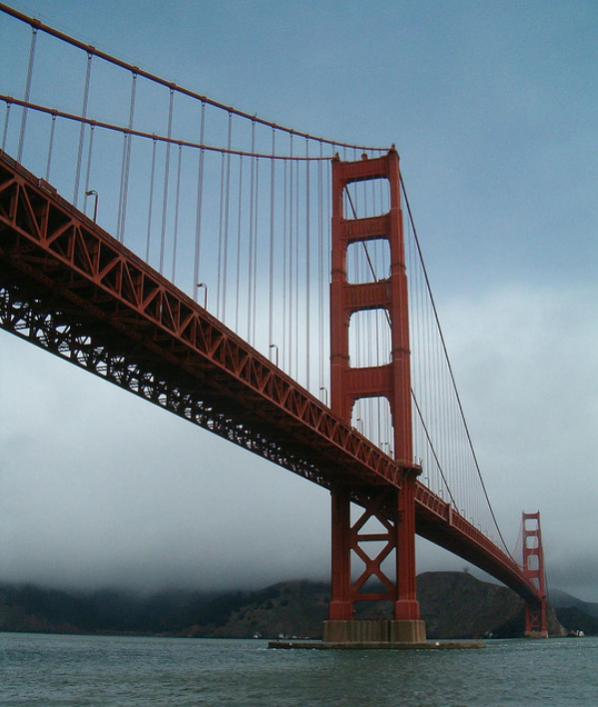
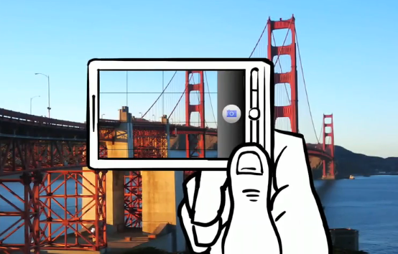
Feature descriptors and feature matching
CS5670: Computer Vision
Prof. Zhu Zhiyu

Slide 2
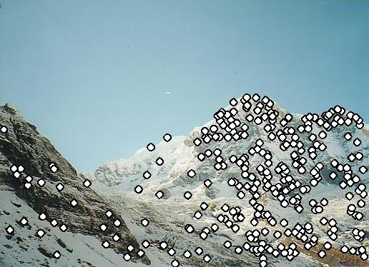
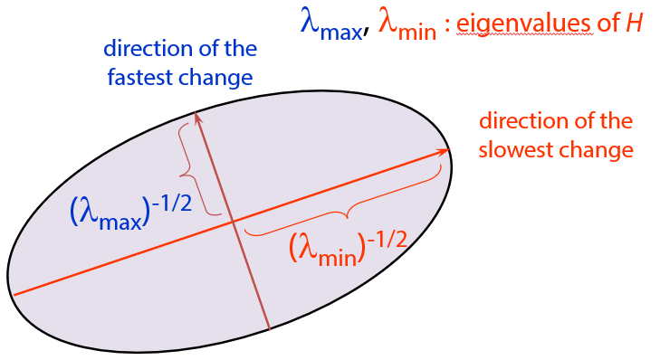
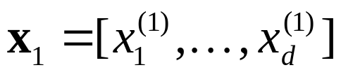
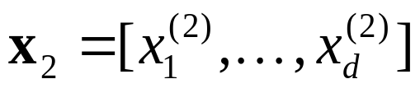
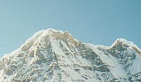

Local features: main components
Detection: Identify the interest points
Description: Extract vector feature descriptor surrounding each interest point.
Matching: Determine correspondence between descriptors in two views
Kristen Grauman

Slide 3

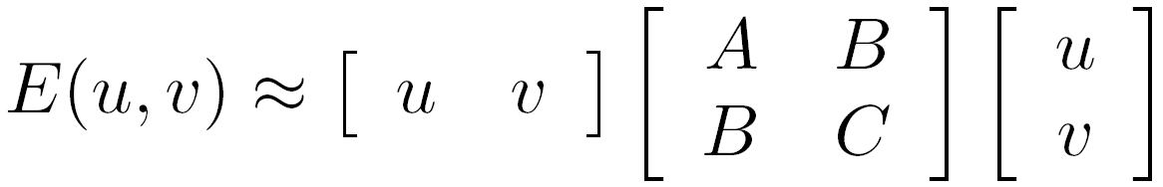
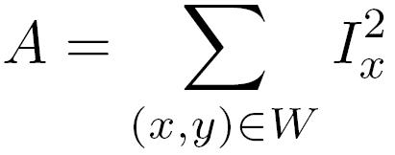

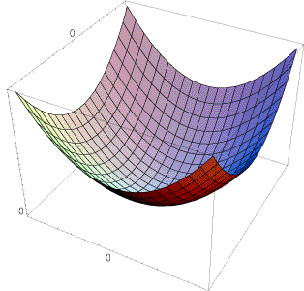
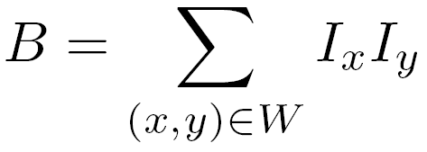
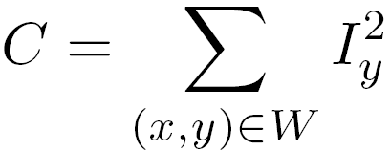
Review of the last lecture
The surface E(u,v) is locally approximated by a quadratic form.
Let’s try to understand its shape.

Slide 4
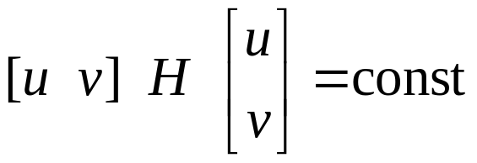
Review of the last lecture
We can visualize H as an ellipse with axis lengths determined by the eigenvalues of H and orientation determined by the eigenvectors of H
λ_{max}, λ_{min} : eigenvalues of H
Ellipse equation:
direction of the fastest change
direction of the slowest change
(λ_{max})^{-1/2}
(λ_{min})^{-1/2}

Slide 5
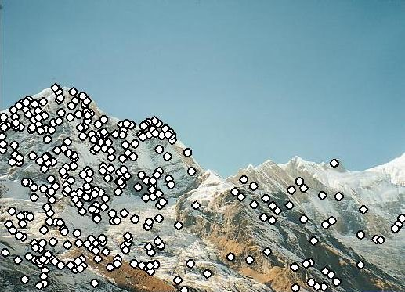
Feature descriptors
We know how to detect good points
Next question: How to match them?
Answer: Come up with a descriptor for each point, find similar descriptors between the two images
?

Slide 6
Feature descriptors
We know how to detect good points
Next question: How to match them?
Lots of possibilities
  Simple option: match square windows around the point
  State of the art approach: SIFT
    David Lowe, UBC http://www.cs.ubc.ca/~lowe/keypoints/
?

Slide 7
Invariance vs. discriminability
Invariance:
  Descriptor shouldn’t change even if image is transformed
Discriminability:
  Descriptor should be highly unique for each point

Slide 8
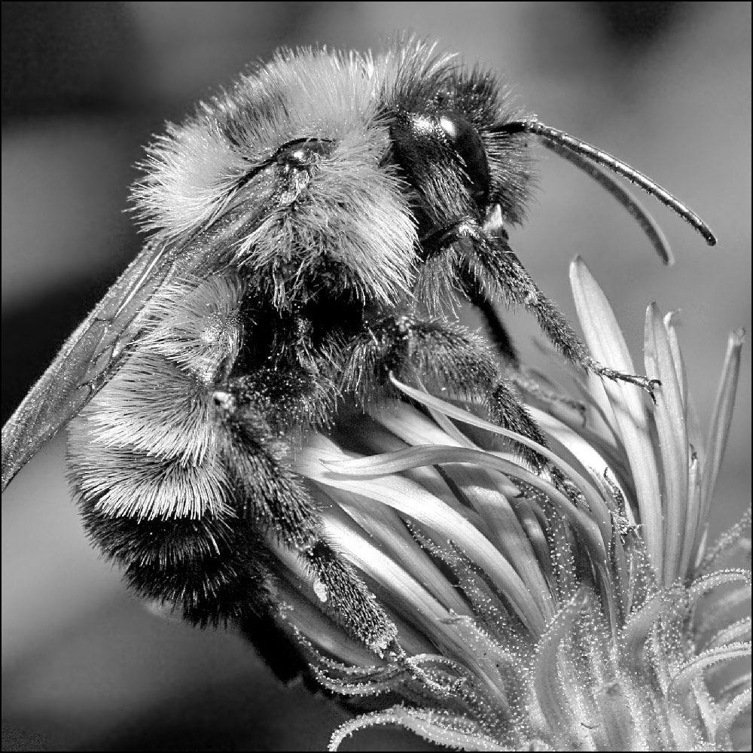
Image transformations revisited
Geometric
  Rotation
  Scale
Photometric
  Intensity change

Slide 9
Invariance
Suppose we are comparing two images I₁ and I₂
  I₂ may be a transformed version of I₁
  What kinds of transformations are we likely to encounter in practice?

Slide 10
Invariant descriptors
We looked at invariant / equivariant detectors
Most feature descriptors are also designed to be invariant to:
  Translation, 2D rotation, scale
They can usually also handle
  Limited 3D rotations (SIFT works up to about 60 degrees)
  Limited affine transforms (some are fully affine invariant)
  Limited illumination/contrast changes

Slide 11
How to achieve invariance
Need both of the following:
Make sure your detector is invariant
2. Design an invariant feature descriptor
  Simplest descriptor: a single 0
    What’s this invariant to?
  Next simplest descriptor: a square, axis-aligned 5x5 window of pixels
    What’s this invariant to?
  Let’s look at some better approaches…

Slide 12
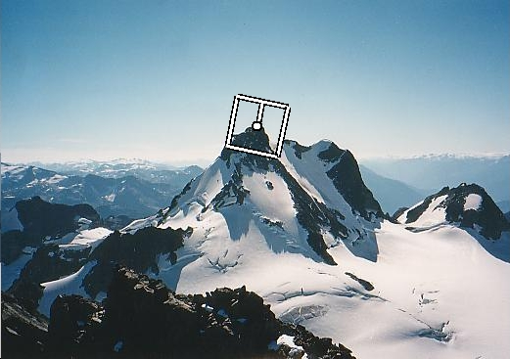
Rotation invariance for feature descriptors
Find dominant orientation of the image patch (this orientation should be equivariant to image rotation)
  E.g., given by x_{max}, the eigenvector of the second moment matrix H corresponding to λ_{max} (the larger eigenvalue)
  Or (better) simply the orientation of the (smoothed) gradient
  Rotate the patch according to this angle
Figure by Matthew Brown

Slide 13
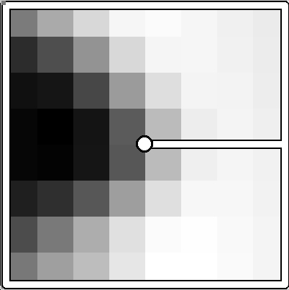
Multiscale Oriented PatcheS descriptor
Take 40x40 square window around detected feature
  Scale to 1/5 size (using prefiltering)
  Rotate to horizontal
  Sample 8x8 square window centered at feature
  Intensity normalize the window by subtracting the mean, dividing by the standard deviation in the window (why?)
40 pixels
8 pixels
Adapted from slide by Matthew Brown

Slide 14
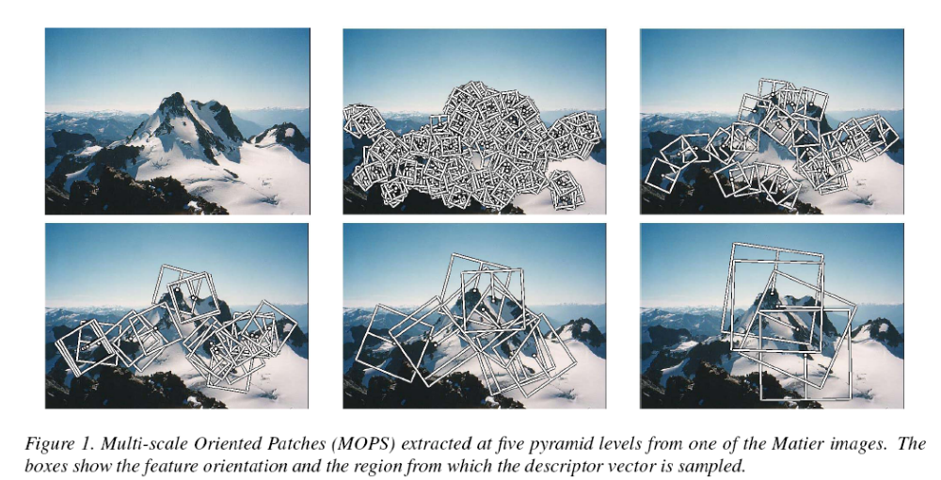
Detections at multiple scales

Slide 15
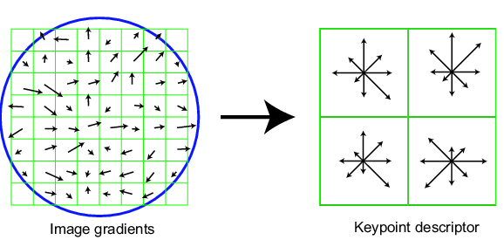
Scale Invariant Feature Transform
Basic idea:
  Take 16x16 square window around detected feature
  Compute edge orientation (angle of the gradient - 90°) for each pixel
  Throw out weak edges (threshold gradient magnitude)
  Create histogram of surviving edge orientations
  Shift the bins so that the biggest one is first
0
2π
angle histogram
Adapted from slide by David Lowe

Slide 16
SIFT descriptor
Full version
  Divide the 16x16 window into a 4x4 grid of cells (2x2 case shown below)
  Compute an orientation histogram for each cell
  16 cells * 8 orientations = 128 dimensional descriptor
Adapted from slide by David Lowe

Slide 17
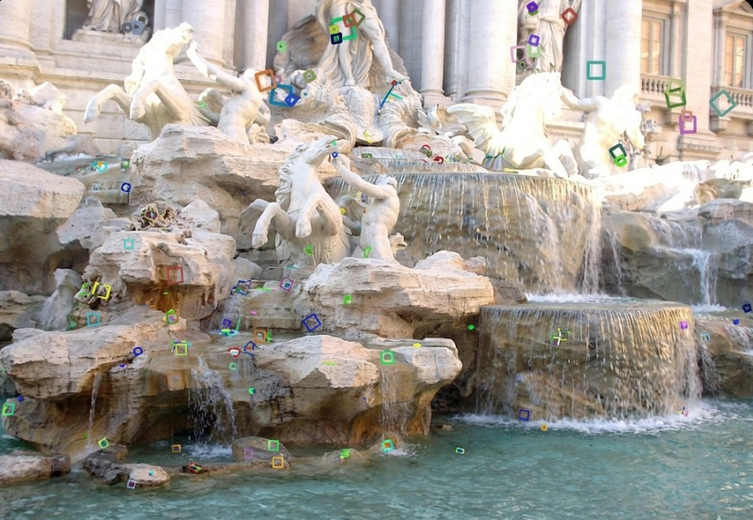
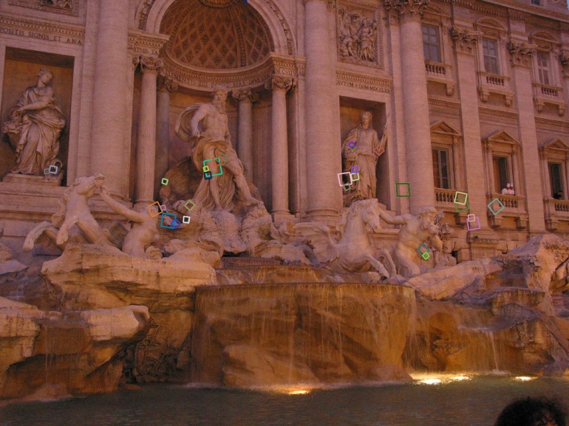
Properties of SIFT
Extraordinarily robust matching technique
  Can handle changes in viewpoint (up to about 60 degree out of plane rotation)
  Can handle significant changes in illumination (sometimes even day vs. night (below))
  Pretty fast—hard to make real-time, but can run in <1s for moderate image sizes
  Lots of code available

Slide 18

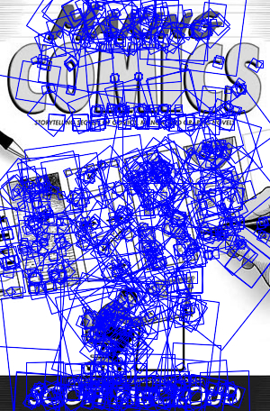
SIFT Example
sift
868 SIFT features

Slide 19
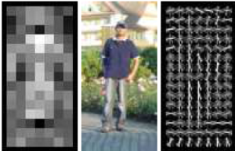
Other descriptors
HOG: Histogram of Gradients (HOG)
  Dalal/Triggs
  Sliding window, pedestrian detection
FREAK (Fast Retina Keypoint) or ORB features
  Can run in real-time; used in Visual SLAM on-device
LIFT: Learned Invariant Feature Transform
  Learned via deep learning – along with many other recent features
    https://arxiv.org/abs/1603.09114
Notes:
http://infoscience.epfl.ch/record/175537/files/2069.pdf
FREAK: Fast Retina Keypoint
The Binary Robust Independent Ele- mentary Feature (BRIEF) [5], the Oriented Fast and Ro- tated BRIEF (ORB)[26], and the Binary Robust Invariant Scalable Keypoints[16] (BRISK) are good examples.

Slide 20
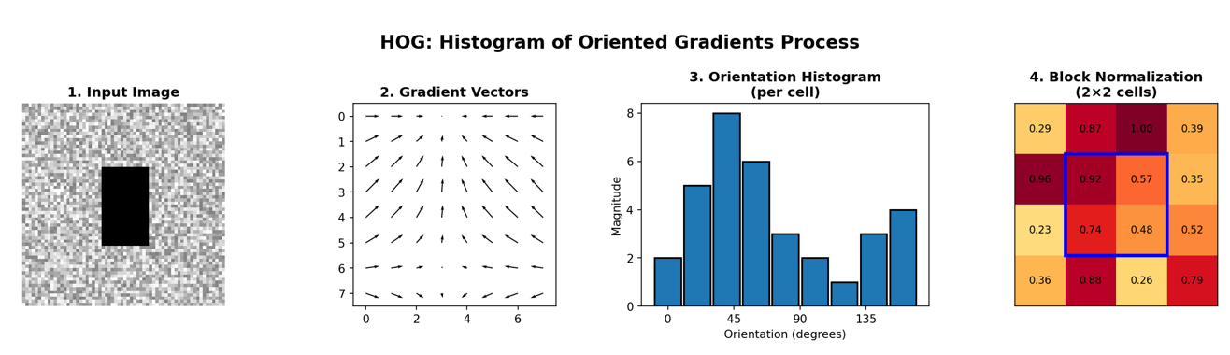
Other descriptors
HOG: Histogram of Gradients (HOG)
  Dalal/Triggs
  Sliding window, pedestrian detection
1. Gradient Computation
- Compute horizontal and vertical gradients using [-1, 0, 1] filters
- Calculate gradient magnitude and orientation at each pixel
2. Cell Histograms
- Divide image into small cells (e.g., 8×8 pixels)
- Create histogram of gradient orientations (typically 9 bins, 0-180°)
- Weight votes by gradient magnitude
3. Block Normalization
- Group cells into overlapping blocks (e.g., 2×2 cells)
- Normalize histograms within each block (L2-norm)
- Provides invariance to illumination changes
Notes:
http://infoscience.epfl.ch/record/175537/files/2069.pdf
FREAK: Fast Retina Keypoint
The Binary Robust Independent Ele- mentary Feature (BRIEF) [5], the Oriented Fast and Ro- tated BRIEF (ORB)[26], and the Binary Robust Invariant Scalable Keypoints[16] (BRISK) are good examples.

Slide 21
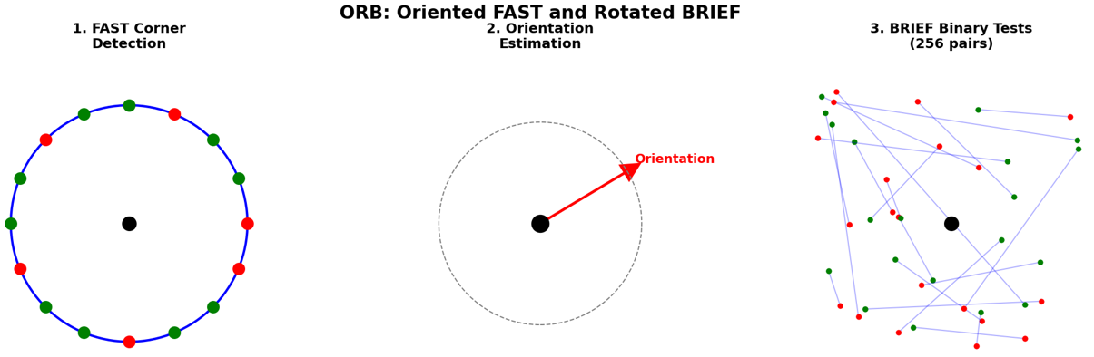
Other descriptors
FREAK (Fast Retina Keypoint) or ORB features
  Can run in real-time; used in Visual SLAM on-device
1. oFAST: Oriented FAST Keypoint Detection
- Uses FAST corner detector to find keypoints
- Computes intensity centroid to determine orientation
- Applies Harris corner measure to rank keypoints
2. rBRIEF: Rotated BRIEF Descriptor
- Binary descriptor: compares intensity of pixel pairs
- 256 bits (256 binary tests)
- Rotates sampling pattern according to keypoint orientation
- Uses learned sampling patterns for better performance
Notes:
http://infoscience.epfl.ch/record/175537/files/2069.pdf
FREAK: Fast Retina Keypoint
The Binary Robust Independent Ele- mentary Feature (BRIEF) [5], the Oriented Fast and Ro- tated BRIEF (ORB)[26], and the Binary Robust Invariant Scalable Keypoints[16] (BRISK) are good examples.

Slide 22
Questions?

Slide 23
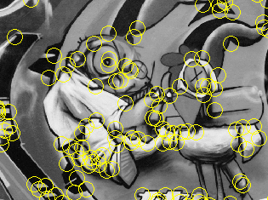
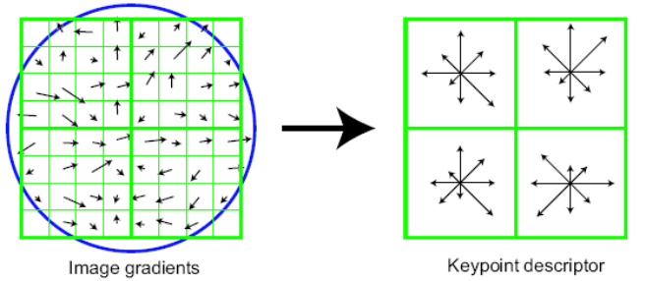
Summary
Keypoint detection: repeatable and distinctive
  Corners, blobs
  Harris, DoG
Descriptors: robust and selective
  spatial histograms of orientation
  SIFT and variants are typically good for stitching and recognition
  But, need not stick to one

Slide 24
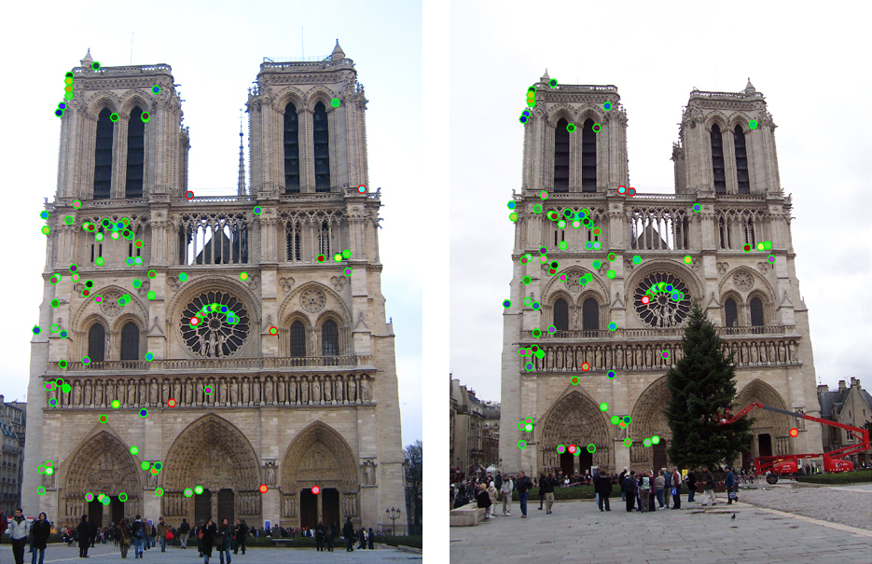
Which features match?

Slide 25
Feature matching
Given a feature in I₁, how to find the best match in I₂?
  Define distance function that compares two descriptors
  Test all the features in I₂, find the one with min distance
  (can be accelerated with a nearest neighbors search data structure, like a kd-tree)

Slide 26
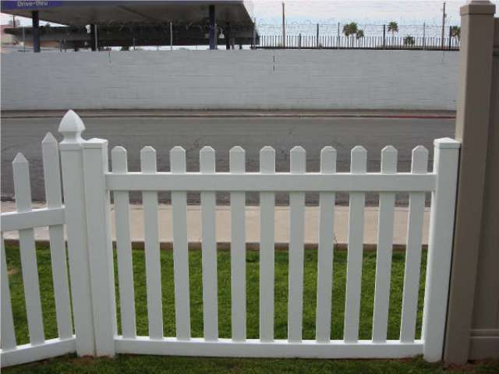
Feature distance
How to define the difference between two features f₁, f₂?
  Simple approach: L₂ distance, || f₁ - f₂ ||
  can give small distances for ambiguous (incorrect) matches
f₁
f₂
I₁
I₂

Slide 27
Feature distance
How to define the difference between two features f₁, f₂?
  Better approach: ratio distance = || f₁ - f₂ || / || f₁ - f₂’ ||
    f₂ is the best SSD match to f₁ in I₂
    f₂’ is the 2nd best SSD match to f₁ in I₂
    gives large values for ambiguous matches
f₁
f₂'
f₂
I₁
I₂

Slide 28
Feature distance
Does the SSD vs “ratio distance” change the best match to a given feature in image 1?
No, but it changes the distance, and it can change the ordering of matches from good to bad
After we compute a set of matches, we threshold by distance (that is, throw out matches with distance > threshold)

Slide 29
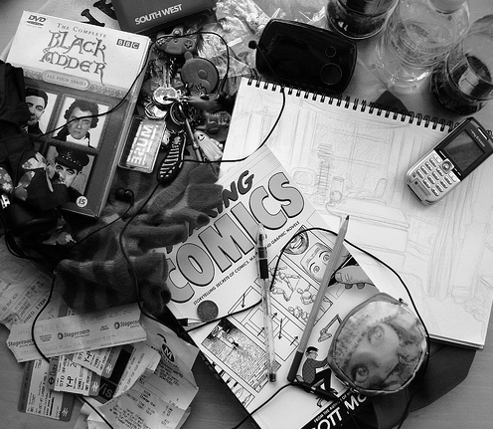
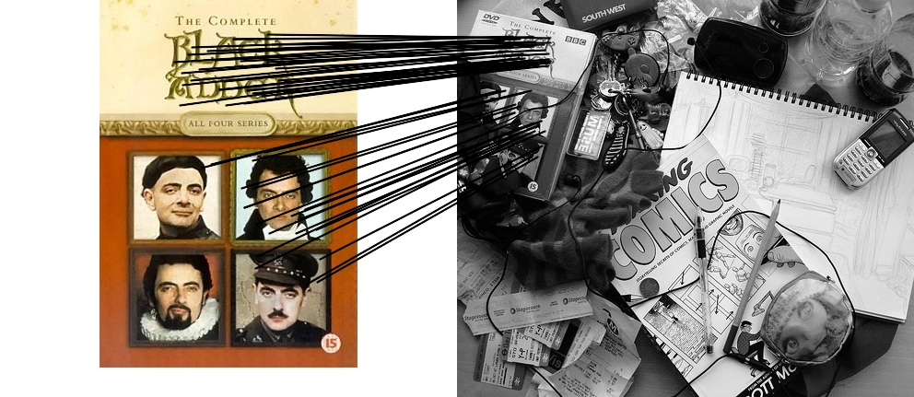
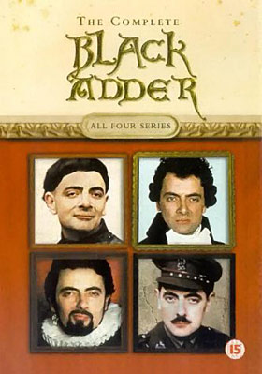
Feature matching example
58 matches (thresholded by ratio score)

Slide 30
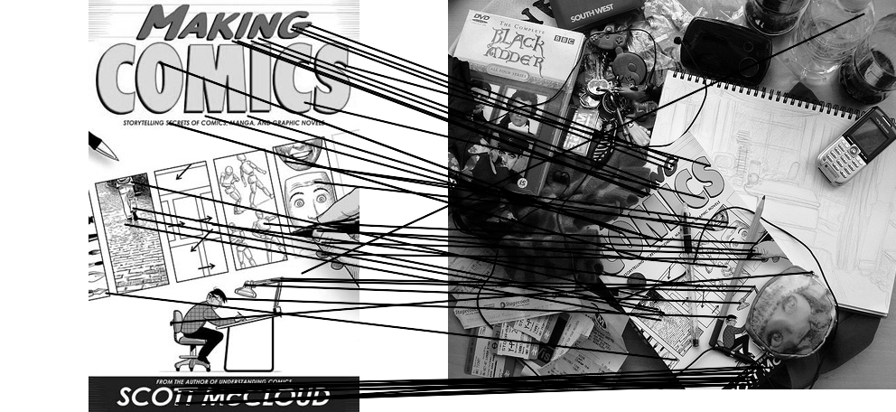

Feature matching example
We’ll deal with outliers later
51 matches (thresholded by ratio score)

Slide 31
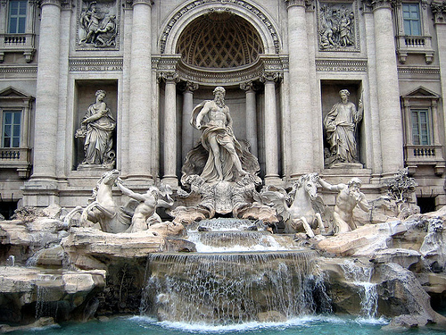
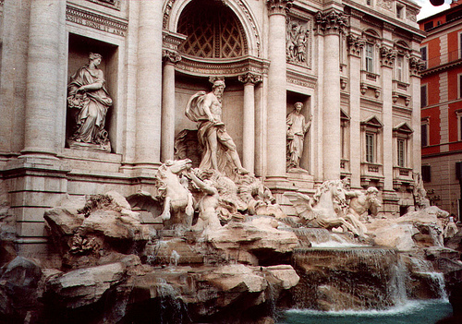
Evaluating the results
How can we measure the performance of a feature matcher?
50
75
200
feature distance

Slide 32
True/false positives
How can we measure the performance of a feature matcher?
The distance threshold affects performance
  True positives = # of detected matches that survive the threshold that are correct
  False positives = # of detected matches that survive the threshold that are incorrect
50
true match
75
200
false match
feature distance

Slide 33
True/false positives
How can we measure the performance of a feature matcher?
Suppose we want to maximize true positives. How do we set the threshold? (Note: we keep all matches with distance below the threshold.)
50
true match
75
200
false match
feature distance

Slide 34
True/false positives
How can we measure the performance of a feature matcher?
Suppose we want to minimize false positives. How do we set the threshold? (Note: we keep all matches with distance below the threshold.)
50
true match
75
200
false match
feature distance

Slide 35
Example
Suppose our matcher computes 1,000 matches between two images
  800 are correct matches, 200 are incorrect (according to an oracle that gives us ground truth matches)
  A given threshold (e.g., ratio distance = 0.6) gives us 600 correct matches and 100 incorrect matches that survive the threshold
  True positive rate = 600 / 800 = ¾
  False positive rate = 100 / 200 = ½

Slide 36
Evaluating the results
How can we measure the performance of a feature matcher?
1
0.7
# true positives surviving threshold
# total correct matches (positives)
true
positive
rate
recall
0
1
false positive rate
0.1
# false positives surviving threshold
# total incorrect matches (negatives)
1 - specificity

Slide 37
Evaluating the results
How can we measure the performance of a feature matcher?
ROC curve (“Receiver Operator Characteristic”)
1
0.7
Single number: Area Under the Curve (AUC)
E.g. AUC = 0.87
1 is the best
# true positives surviving threshold
# total correct matches (positives)
true
positive
rate
recall
0
1
false positive rate
0.1
# false positives surviving threshold
# total incorrect matches (negatives)
1 - specificity

Slide 38
ROC curves – summary
By thresholding the match distances at different thresholds, we can generate sets of matches with different true/false positive rates
ROC curve is generated by computing rates at a set of threshold values swept through the full range of possible thresholds
Area under the ROC curve (AUC) summarizes the performance of a feature pipeline (higher AUC is better)

Slide 39
Lots of applications
Features are used for:
  Image alignment (e.g., mosaics)
  3D reconstruction
  Motion tracking
  Object recognition
  Indexing and database retrieval
  Robot navigation
  … other

Slide 40
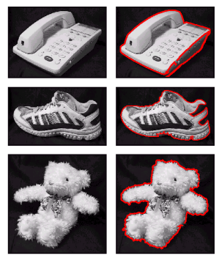
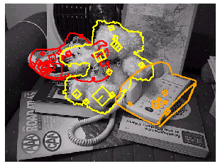
Object recognition (David Lowe)

Slide 41
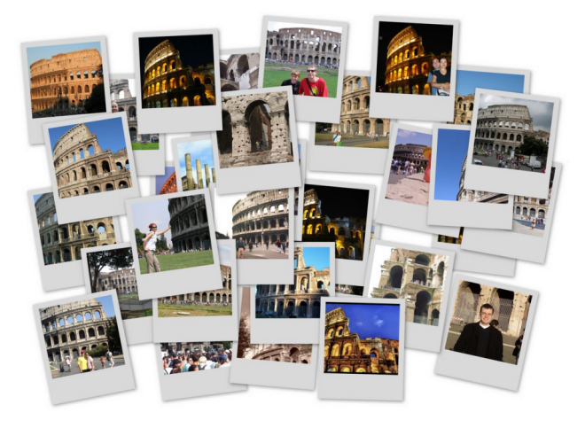
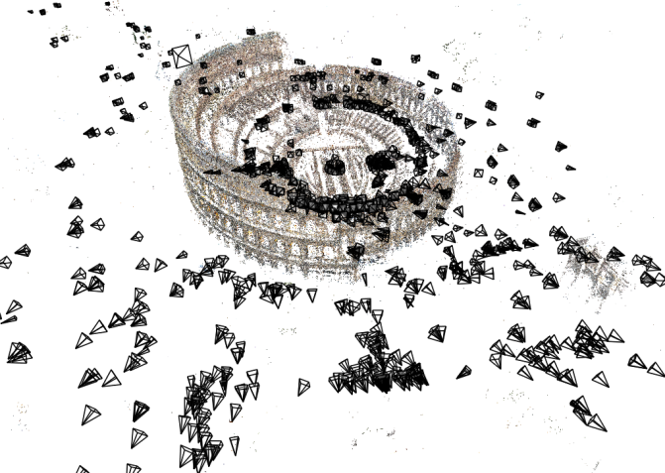
3D Reconstruction
Internet Photos (“Colosseum”)
Reconstructed 3D cameras and points

Slide 42
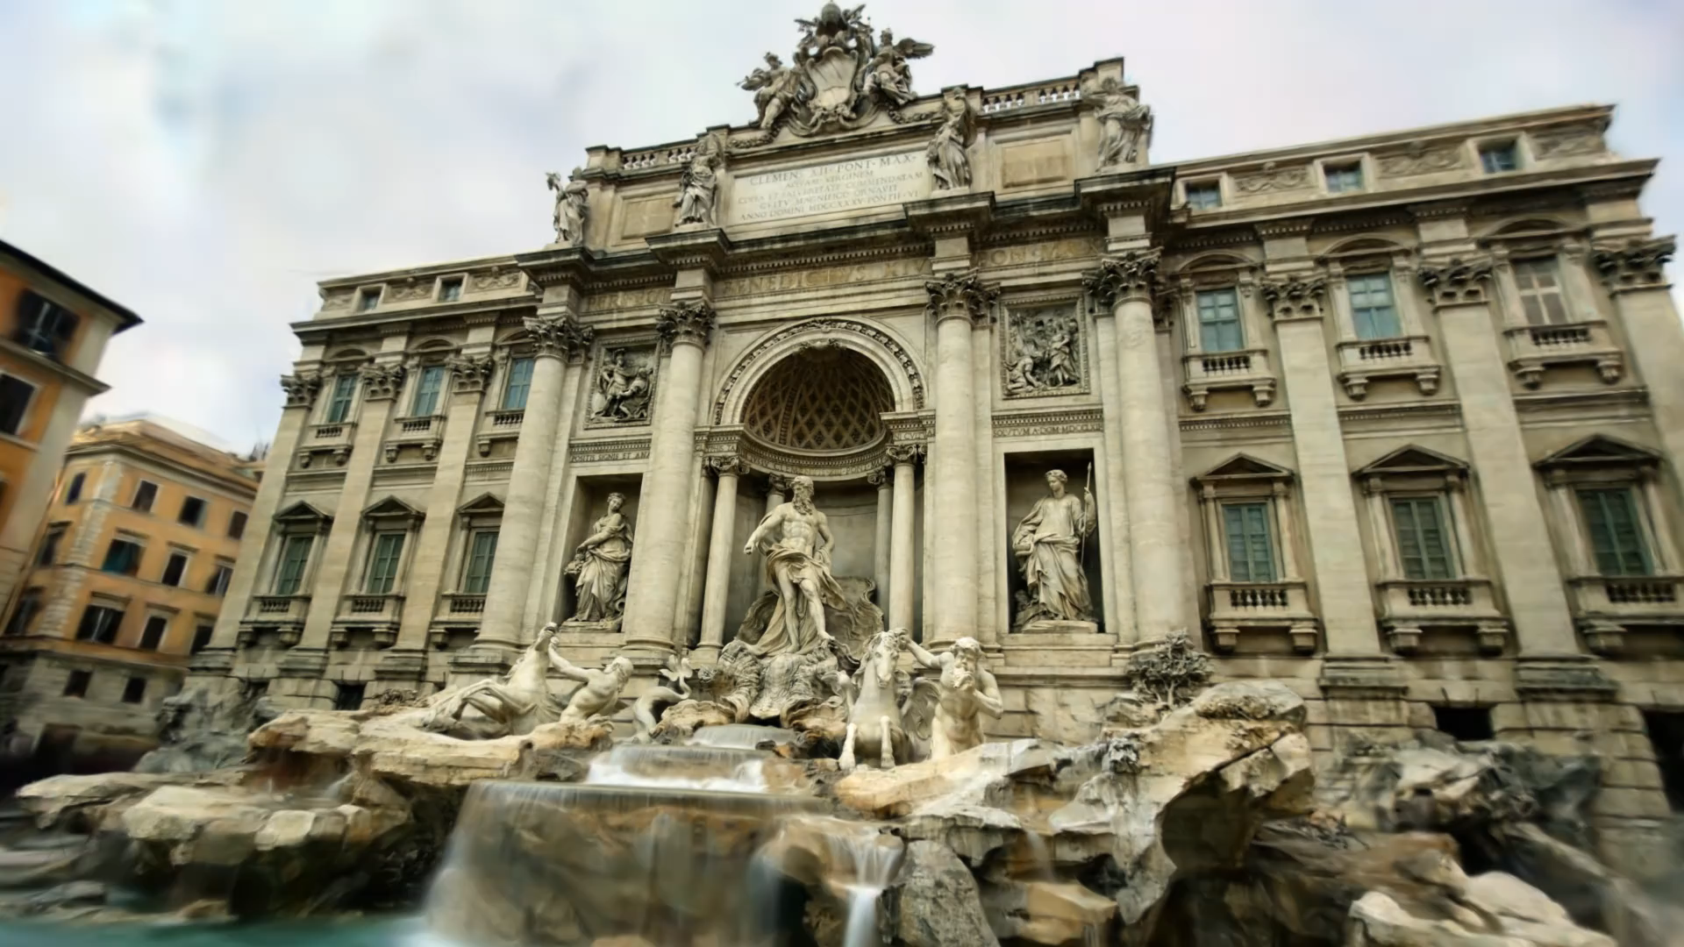
WildGaussians: first reconstruct cameras using feature matching, then create dense model
Kulhanek, et al. WildGaussians. NeurIPS 2024

Slide 43
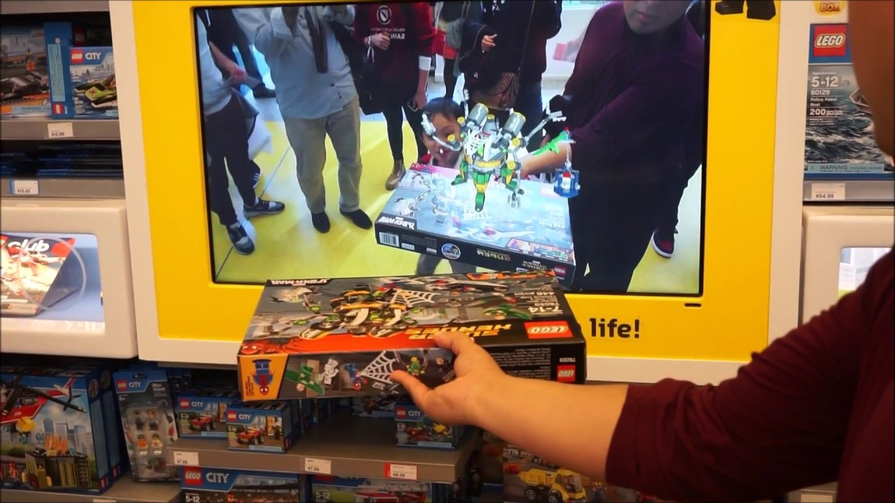
Augmented Reality

Slide 44
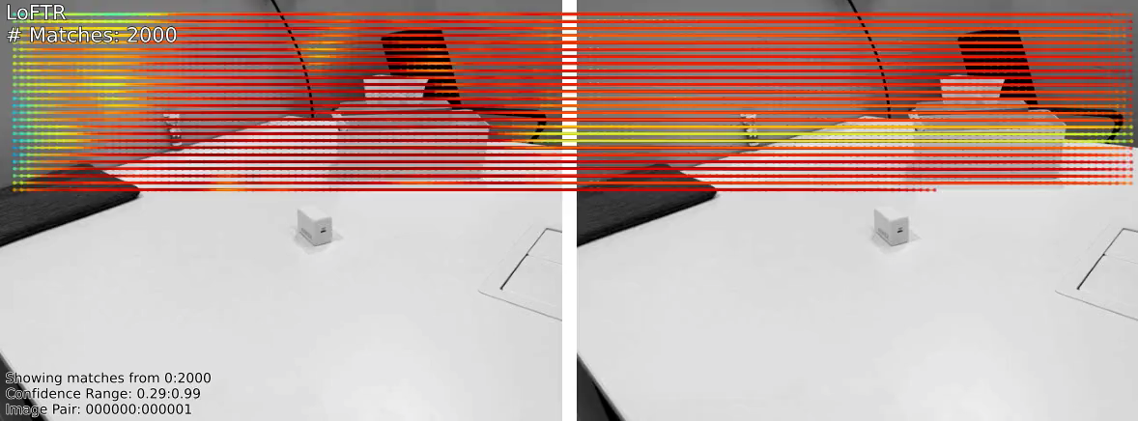
Learned feature matchers
LoFTR: Detector-Free Local Feature Matching with Transformers
CVPR 2021 [Sun, Shen, Wang, et al.]

Slide 45
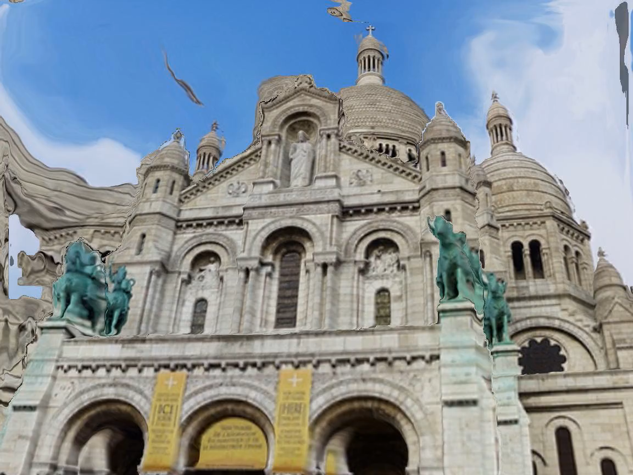
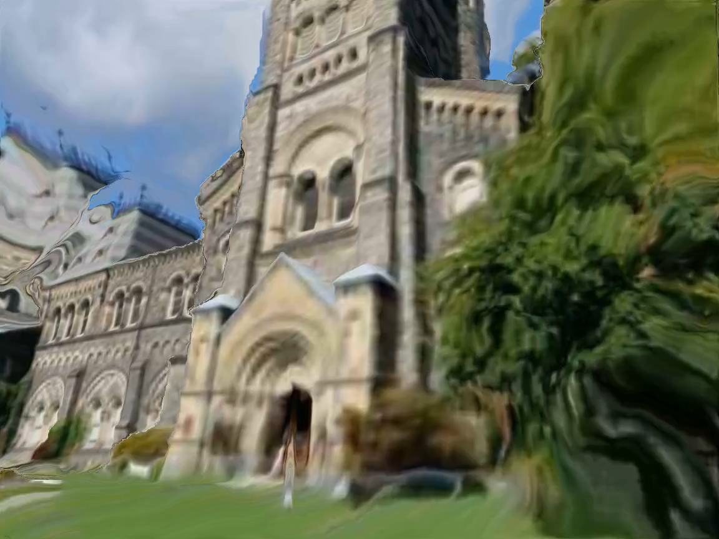
Learned feature matchers
RoMa: Robust Dense Feature Matching, CVPR 2024

Slide 46
Questions?

